Slide 1
American Literature with U.S. History
Welcome to Class!
A Brief Overview of American Literary Periods

Slide 2
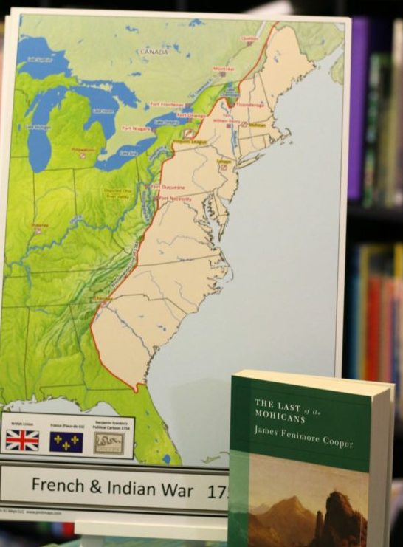
Combining American Literature with History Studies
Early historical records.
Founding documents
Humorous short stories
Thought provoking poems
Gothic tales
Historic narratives
Fiction depicting the times
All of them provide a perspective of United States History through the voices of American authors.

Slide 3
A Visual Journey
Link to American Literature Study Guide Timeline

Slide 4
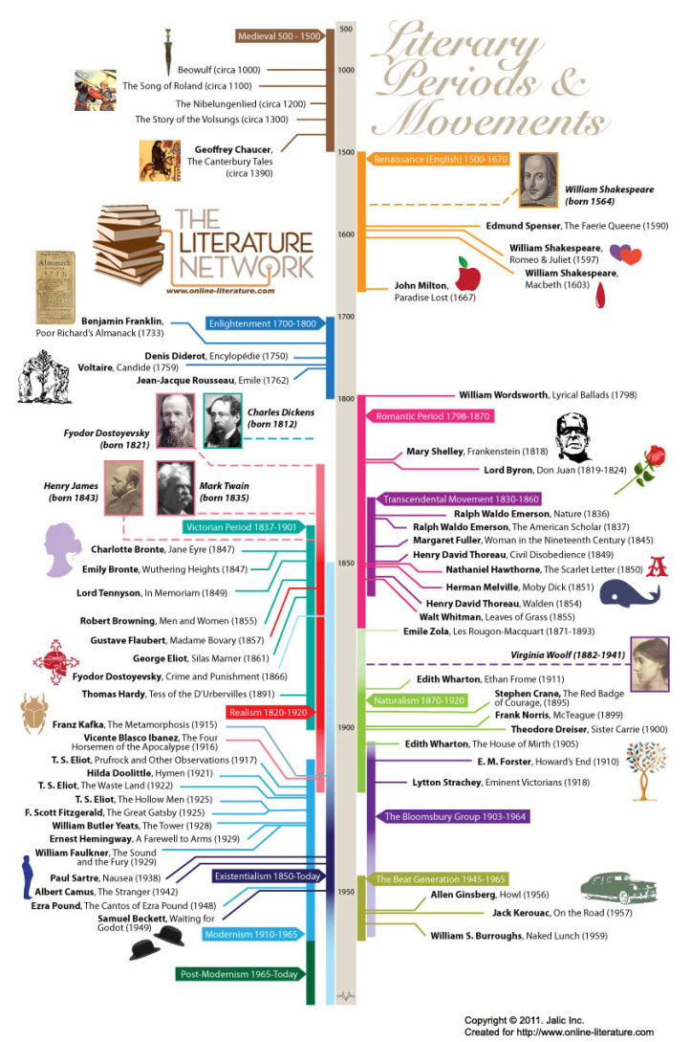

Slide 5
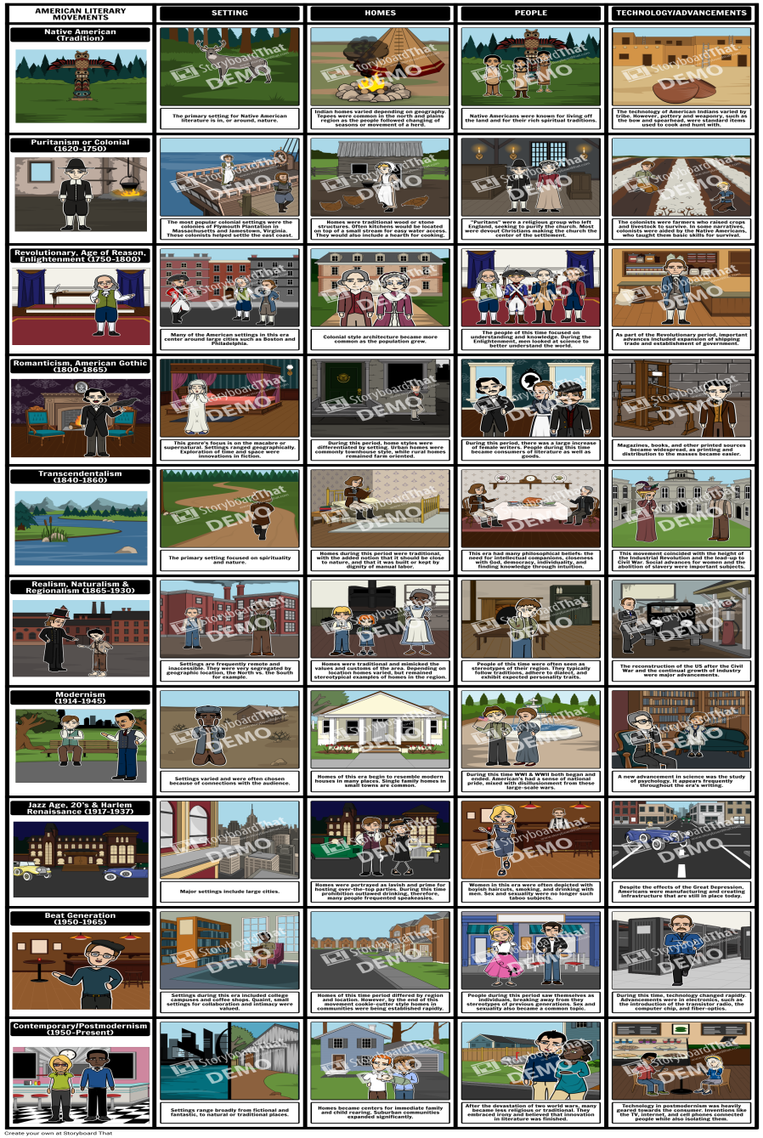
American Literary Movements - Characteristics of the Periods
American Literary Movements - Characteristics of the Periods

Slide 6
What is the relationship between American history and American literature?
Connection between a work and its historical setting as well as the era in which the author has lived.
Literature is the recording of human experience, and that experience derives from the historical incidents as well as the thinking of its era.
Certain themes in a short story or novel is very reflective of the thinking and literary movement of the time in which the work is written

Slide 7
A Different Perspective
When you study American literature in its cultural context, you enter a multi-disciplined and multi-voiced conversation where scholars and critics in different fields examine the same topic but ask very different questions about it.
For example, how might a literary critic’s understanding of nineteenth century American culture compare to that of a historian of the same era?
How can an art historian’s understanding of popular visual metaphors enrich our readings of literature?

Slide 8
Literary Movements and Historical Change
In general, people think about literary movements as reacting against earlier modes of writing and earlier movements.
For example, just as modernism is often seen as a response to realism and the Gilded Age so Romanticism is seen as a response to the Enlightenment .

Slide 9
Unit Essential Questions
Questions at the start of each unit are meant to help you focus your viewing and reading and participate in discussion afterward.
Unit 1. What is an American? How do history and literature create conceptions of the American experience and American identity?
This two-part question should trigger discussion about issues such as, Who belongs to America? When and how does one become an American? How has the search for identity among American writers changed over time? It can also encourage discussion about the ways in which immigration, colonization, conquest, youth, race, class, and gender affect national identity.

Slide 10
Course Outline & Contract
Read through.
Return the signed contract to me next class.

Slide 11
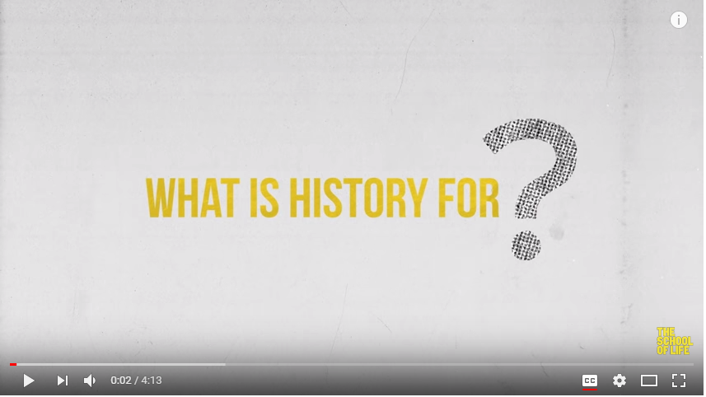
What is History for?
The fundamentals about History and why we need it.

Slide 12
Ice-Breaker: Who I Am
(PDF)
Complete page 1 (about yourself).
Complete page 2 by asking 20 people one question:
Name
Response to question

Slide 13
Log Onto Computers
Let me know if I need to reset your password.
I’ll need your student # and date of birth (year, month, day).
Then open the class website:
MclinAmericanExperience.weebly.com
Password is westmont

Slide 14
Join Google Class
Go to classroom.google.com
Your class code is:
Open the “Test Upload” assignment and tell me about your plans for after you graduate and beyond.
When you finish, press “Submit”.

Slide 15
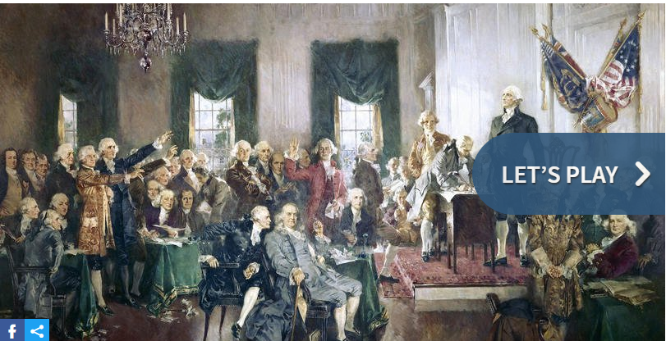
US History Quiz
Quick US History Quiz (link)

